Slide 1
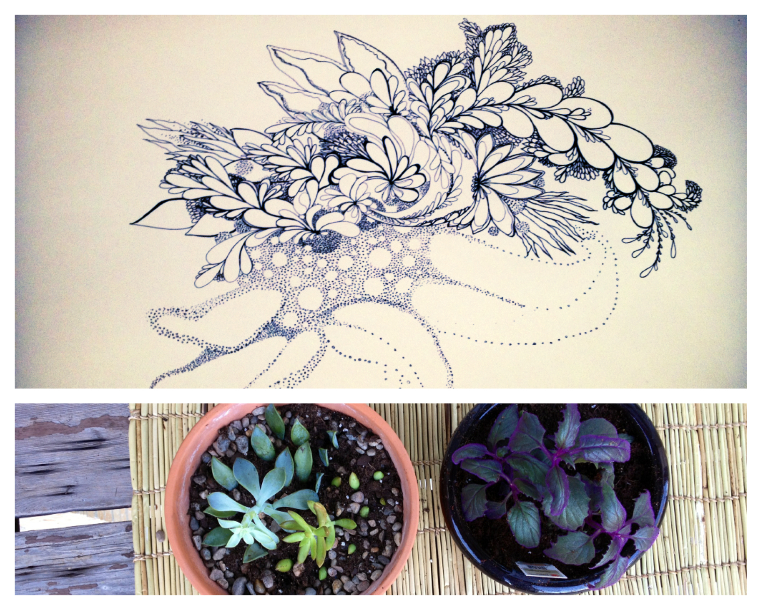

Slide 2
Who are we?
Bryn Naranjo, MA, LMHC Artistic Director of Buen Viaje Dance (BVD) company at VSA of New Mexico
Tamara R. Schardt, BFA, MS Art Therapist Artist-Teacher at VSA of New Mexico/North Fourth Art Center Rita Celeste Leon
Bicycle Yogi & Nutritionist bicyclesyogaandyou.com We want to get to know YOU!

Slide 3
PURPOSE

Slide 4
Plan for Today:
1- Introductions
2- Self-Care 3. Deep Breathing Practice
4- Creative Movement / Yoga
4- Mandalas – History & Info
5- Create your own Mandala
6. Questions?

Slide 5
Self – Care
balance

Slide 6
What is Self-Care?
“Self-care is what people do for themselves to establish and maintain health, prevent and deal with illness. It is a broad concept encompassing: • hygiene (general and personal); • nutrition (type and quality of food eaten); • lifestyle (sporting activities, leisure etc.); • environmental factors (living conditions, social habits, etc.); • socioeconomic factors (income level, cultural beliefs, etc.); • self-medication.” -World Health Organization 2015

Slide 7
Importance of Self-Care
Boosts self-confidence
Increases emotional & physical stability
Strengthens relationships
Overall - a happier, healthier person ☺

Slide 8
Importance of Self-Care: Caretakers
Caretakers of all personal and professional realms need to practice self-care in order to prevent burnout/compassion fatigue
Nurses & caretakers need to use social support and address own feelings in order to positively cope with patients’ and families’ grief (Saunders & Valente, 1994).
NEGLECTED AREAS:
“dealing with their own emotional reactions when caring for patients” (Nainis, 2005, p. 150).
Processing their own bereavement (Boyle, 2000).

Slide 9
Self-Care Importance: Healthcare Professionals
Individuals with “…non-remitting stress often have multiple behaviors that put them at greater risk: poorer sleep, propensity to substance abuse, poorer nutrition and less exercise” (Hass-Cohen & Carr, 2008, p. 208).
Training a new nurse = entire annual salary of a staff RN (Nainis, 2005).
High levels of stress= burnout of personnel
“…emotional fatigue, loss of identity, and frustration with terminal illness” (Nainis, 2005).
Oncology nurses especially susceptible to this (Boyle, 2000; Lewis, 1999; Nainis, 2005).

Slide 10
Practice: Deep Breathing
Other names: “Diaphragmatic breathing” or “belly breathing”
When you breathe in deeply through your nose, the lungs fill up fully, and your belly expands
Shallow breathing limits the diaphragm’s range of motion; this can make you feel short of breath and anxious
Deep abdominal breathing encourages full oxygen exchange; this slows the heartbeat and lowers or stabilizes blood pressure. -Harvard Health Publications, 2015

Slide 11
Practice: MOVEMENT
Be Spontaneous and Courageous in your movement
Listen to your body! If it hurts, adapt the movement to your needs; be gentle on yourself.
Remember: keep practicing deep breathing
Focus: on your breath, the movement of your body, and expression
Let go: of the daily distractions and negativity

Slide 12
Deep Breathing and Movement
Relax. Listen to your body. Relish in the moment and let go.

Slide 13
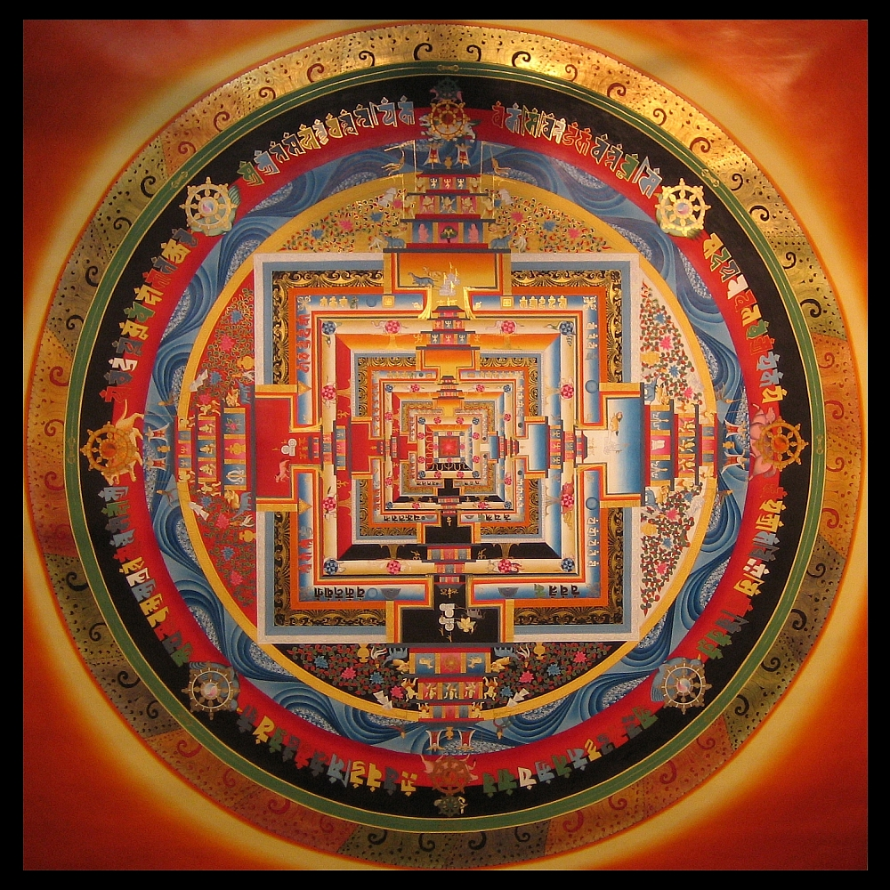
MANDALA
“Center” or “Self” or “Sacred Circle”

Slide 14
MANDALA
Translated from Sanskrit, meaning “magic circle” and “center” –represents wholeness (Fincher, 2010).
In art therapy, mandala making is used to reduce stress and center oneself (DeLue, 1999; Fincher, 2010; Kellogg, 1978, Malchiodi, 1998, Wolf Bordonaro, 2010).
Carl Jung – “a representation of the unconscious self”
Rhoda Kellogg – collected thousands of children’s drawing from across the world; the circle motif represented self or parts of nature in every culture
DeLue’s Biofeedback study – School children drew within a circle (mandala). Their heart rates lowered by approximately 7 beats per minute; they reported feeling relaxed.

Slide 15
Mandalas in All Cultures
*Buddhism: uses a variety of mandalas as sacred representations (Cosmic, Kalachakra, meditation…)
*Navajo: medicine wheel, person/patient afflicted in center *Plains Natives: dream catchers & dance shields
*Mayan & Aztec calendars
*In most cultures, the mandala is rich in repeated patterns and symmetry *In the West, the mandala is also used to refer to the "personal world" in which one lives, the various elements of the mandala being the activities and interests in which one engages, the most important being at the centre of the mandala, and the least important at the periphery. Depicting one's personal mandala in pictorial form can give one a good indication of the state of one's spiritual life.

Slide 16
Create Your Mandala
Ideas/Options for your mandala:
1-Where do you draw your strength? Capture that in your mandala drawing (nature, family, inner resilience because of past experience).
2-What is your symbol of self? Depict it in your mandala.
3-If neither of those directives suit you, start your free form mandala with lines, patterns…and work from the center outward.
Gather materials that are comfortable to you.
Always start a mandala in the center of the circle and work outward.

Slide 17
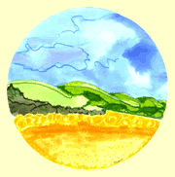
“Because there are innumerable things beyond the range of human understanding, we constantly use symbolic terms to represent concepts that we cannot define or fully comprehend.” -C.G. Jung

Slide 18
Questions? Thank you for your time today!
*email additional questions or feedback to Tamara: tschardt@vsartsnm.org

